Slide 1
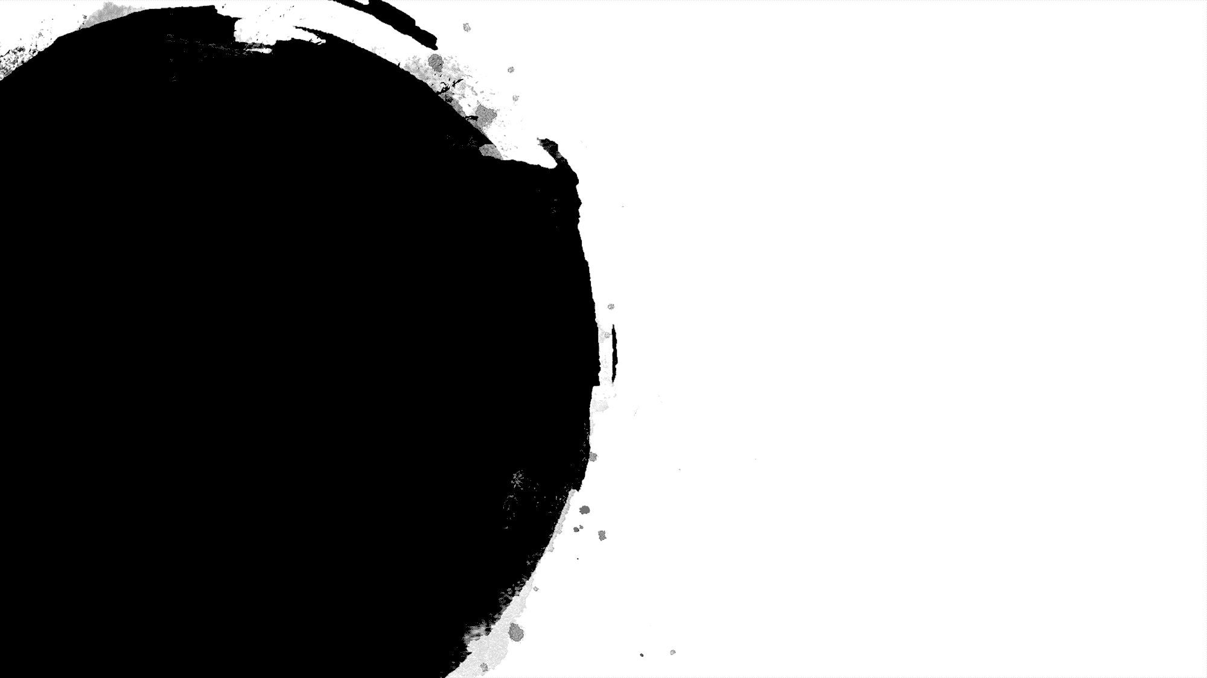

Random Forest Group 22
Amanda Aleong
Francis Cruz
Han Hu
Youngmok Ko
Hao Xing
Shi Yu

Slide 2

Random Forest
Random Forest Comparisons Code Classification Regression Conclusion
Supervised ML algorithm used for classification or regression
Ensemble technique which utilizes multiple decision trees
The power of crowd
Another example of an ensemble technique:
Bagging
Notes:
Random forests are a supervised machine learning algorithm that can be used for both classification and regression. It is also an ensemble technique that utilizes multiple decision trees. Essentially you would have an input and you would feed it to a forest of decision trees. Each individual tree will provide an output be it a class for classification or value for regression. The mode of the class or the mean of the values will be used as the output for both classification and regression respectively. This indicates the main principle of ensemble techniques which utilizes multiple models to provide a better robust prediction of the outcome of the problem - the power of the crowd. Another example of an ensemble technique is bagging. The difference between RF and bagging will be discussed later.

Slide 3

Exploring a Random Forest
Notes:
Let’s talk about how we actually build a random forest.

Slide 4
Planting a Random Forest: n_estimator = 3
Random Forest Comparisons Code Classification Regression Conclusion
Sample# | F1 | F2 | F3
1
2
3
4
5
6
Set aside as test data
Notes:
Suppose we have 6 samples and 3 features. We set aside the sixth one as a test case.

Slide 5
Planting a Random Forest: n_estimator = 3
Random Forest Comparisons Code Classification Regression Conclusion
Sample# | F1 | F2 | F3
1
2
3
4
5
Step 1: Bootstrap sample
Notes:
We perform a bootstrap sample of this dataset to produce another data set. For example, lets select samples 1, 2 and 4 to create this new subset. Within this new subset, we randomly select m out of M features to create a new training set to construct a tree. For example, lets randomly select features 1 and 3, and use this to make a tree.

Slide 6
Planting a Random Forest: n_estimator = 3
Random Forest Comparisons Code Classification Regression Conclusion
Sample# | F1 | F2 | F3
1
2
3
4
5
Sample# | F1 | F2 | F3
1
2
4
Step 1: Bootstrap sample
Step 2: Select m features
Setting Up Estimator #1
Notes:
We perform a bootstrap sample of this dataset to produce another data set. For example, lets select samples 1, 2 and 4 to create this new subset. Within this new subset, we randomly select m out of M features to create a new training set to construct a tree. For example, lets randomly select features 1 and 3, and use this to make a tree.

Slide 7
Planting a Random Forest: n_estimator = 3
Random Forest Comparisons Code Classification Regression Conclusion
Sample# | F1 | F2 | F3
1
2
3
4
5
Sample# | F1 | F2 | F3
1
2
4
Sample# | F1 | F3
1
2
4
Step 1: Bootstrap sample
Step 2: Select m features
Step 3: Pass as input to tree# 1
Setting Up Estimator #1
Notes:
We perform a bootstrap sample of this dataset to produce another data set. For example, lets select samples 1, 2 and 4 to create this new subset. Within this new subset, we randomly select m out of M features to create a new training set to construct a tree. For example, lets randomly select features 1 and 3, and use this to make a tree.

Slide 8
Planting a Random Forest
Random Forest Comparisons Code Classification Regression Conclusion
Create n bootstrap sample sets
Select m features
Train each tree in parallel
Aggregate outcome of each tree by taking
the mode of the classes (classification) or
the mean of the prediction (regression)
Sample# | F1 | F2 | F3
1
2
3
4
5
Sample# | F1 | F2 | F3
2
4
5
Sample# | F1 | F2
2
4
5
Step 1: Bootstrap sample
Step 2: Select m features
Step 3: Pass as input to tree# 2
Setting Up Estimator #2
Notes:
We repeat this process multiple times for each tree. For example, we do the same for tree 2.

Slide 9
Planting a Random Forest
Random Forest Comparisons Code Classification Regression Conclusion
Create n bootstrap sample sets
Select m features
Train each tree in parallel
Aggregate outcome of each tree by taking
the mode of the classes (classification) or
the mean of the prediction (regression)
Sample# | F1 | F2 | F3
1
2
3
4
5
Sample# | F1 | F2 | F3
2
3
4
Sample# | F2 | F3
2
3
4
Step 1: Bootstrap sample
Step 2: Select m features
Step 3: Pass as input to tree# 3
Setting Up Estimator #3
Notes:
And tree 3

Slide 10
Growing a Random Forest
Random Forest Comparisons Code Classification Regression Conclusion
Sample# | F1 | F3
1
2
4
F3
n1
F1
Sample# | F1 | F2
2
4
5
F2
n2
F1
Sample# | F2 | F3
2
3
4
F3
n3
F2
F3
Notes:
So here we have our trained trees.

Slide 11
Roaming a Random Forest
Random Forest Comparisons Code Classification Regression Conclusion
Sample# | F1 | F2 | F3
6
F3
1
F1
Sample# | F1 | F2 | F3
6
F2
0
F1
Hyperparameters:
Min_samples_leaf
Criterion
Max_depth
N_estimators
Max_features
Sample# | F1 | F2 | F3
6
F3
F2
1
F3
Notes:
So here we have our trained trees. We then input sample 6 into the trees and we receive the class outputs for each tree. We take a majority vote – 2 trees showed 1 and one tree showed zero. Hence, the output of the random forest is 1. Some hyperparameters for the random forest such as minimum number of samples each leaf can hold, the criterion which determines the best splits, maximum depth of the tree, number of trees, and the number of features to consider when splitting the nodes.

Slide 12
Difference Between RF and Bagging
Random Forest Comparisons Code Classification Regression Conclusion
 | Bagging | Random Forest
Ensemble Technique | Yes | Yes
Uses Decision Trees | Sometimes | Always
Bootstrap Sampling | Yes | Yes
Feature space per tree | Uses all M features | Uses m features <M
Reduces Variance | Yes | Yes
Reduces correlation | No | Yes
Notes:
Now that we know how an RF works, lets compare it to other ensemble techniques such as bagging. Bagging and RF are both ensemble techniques in which they utilize multiple models to predict either a class or a value. Bagging does not necessarily need to involve decision trees, rather they can be any ML model, whereas RF specifically involves decision trees. Bagging and RF both involve bootstrapping. However, when creating subsets of the data, bagging uses the entire feature space of your data whereas RF randomly selects the features to be used. Both reduce variance through the use of multiple models. Random forest reduces the correlation between the trees as you restrict it to train on select number of features unlike bagging. For example, suppose that there is one very strong predictor in the data set, along with other relatively strong features. Then in a collection of bagged trees, most or all of the trees will use the strong predictor at the top split. Consequently, all of the bagged trees will look quite similar to one another. Hence, the predictions from the bagged trees will be highly correlated. Random forests overcome by considering only a subset of the predictors and hence, will construct different structures of trees.

Slide 13
Random Forest and Cross Validation
Random Forest Comparisons Code Classification Regression Conclusion
Cross-Validation:
Random Forest
Fold 1 | Fold 2 | Fold 3 | Fold 4
Random forest already subsamples the data set to train each tree.
Out-of-bag score: aggregated accuracy from trees where a sample was not a part of the subset used for training.
Run 1
Run 2
Run 3
Run 4
Training set
Test set
Notes:
How do we measure the accuracy of a random forest? Random forests and cross validation are quite similar. Cross validation involves the partition of the training data set, where one of the segments will be used as test data. You perform this task several times based on the number of partitions, then take the average of the output. On the other hand, RF already subsamples the data set to train each tree. Typically, only 2/3 of the data are used to train the trees and the remaining 1/3 will be used to test the model. This score for the test set is the out of bag score.
The RandomForestClassifier is trained using bootstrap aggregation, where each new tree is fit from a bootstrap sample of the training observations zi=(xi,yi). The out-of-bag (OOB) error is the average error for each zi calculated using predictions from the trees that do not contain zi in their respective bootstrap sample. This allows theRandomForestClassifier to be fit and validated whilst being trained
https://scikit-learn.org/stable/auto_examples/ensemble/plot_ensemble_oob.html

Slide 14
Random Forest
Random Forest Comparisons Code Classification Regression Conclusion
Advantages
Handle missing values and maintains accuracy for missing data
Less likely to overfit the model
Handle large data set with higher dimensionality
Disadvantages
Computational complexity (Computationally expensive/takes long to solve)
Feels like a black box approach (Loss of explainability)
Notes:
Some of advantages of RF include handling missing data, less likely to overfit the model, and handling large data sets with higher dimensionality. Some disadvantages include the increased computational complexity of the forest, and it feels like a black box approach where it becomes harder to explain the models for each individual tree.

Slide 15
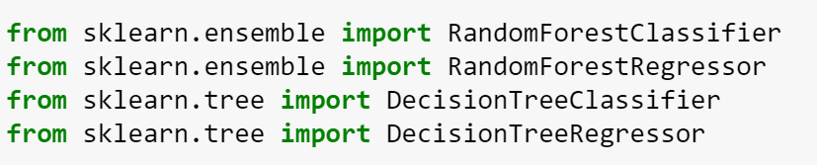
Python Code: Import Libraries and Data
Random Forest Comparisons Code Classification Regression Conclusion
Library
Import Data
Notes:
Here are the basics of the code to use random forests. For this section, we will show code that can uses both decision trees and random forests. First, we import libraries from sklearn.ensemble and sklearn.tree for both randomforest and decisiontree respectively. We then import the data. For this presentation, we will be using a heart disease detection problem and a housing pricing regression problem based on certain house attributes. The code for each of these are quite similar to one another.

Slide 16
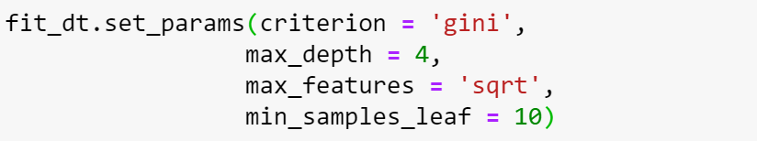
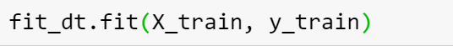
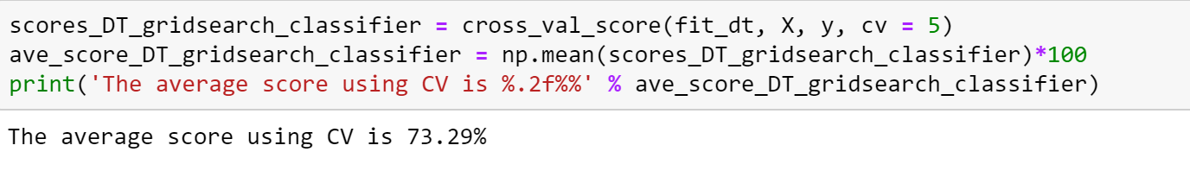
Python Code: Decision Tree Classification
Random Forest Comparisons Code Classification Regression Conclusion
Instance
Set Parameters
Training
Predict
Assess
Notes:
First, we create an instance of the model. We then set the parameters based on a result of a grid search to determine optimal parameters to start with. We then train the data and form predictions based on testing data sets. We then use the score parameter which provides an accuracy of the prediction. Similar code are used for the classification and regression problem for random forests.

Slide 17
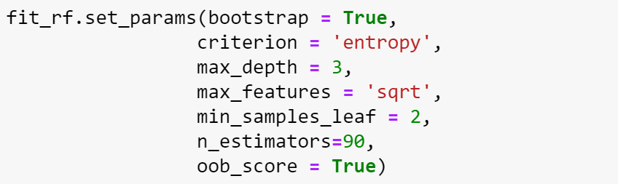
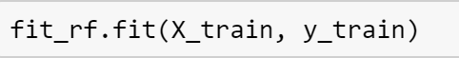
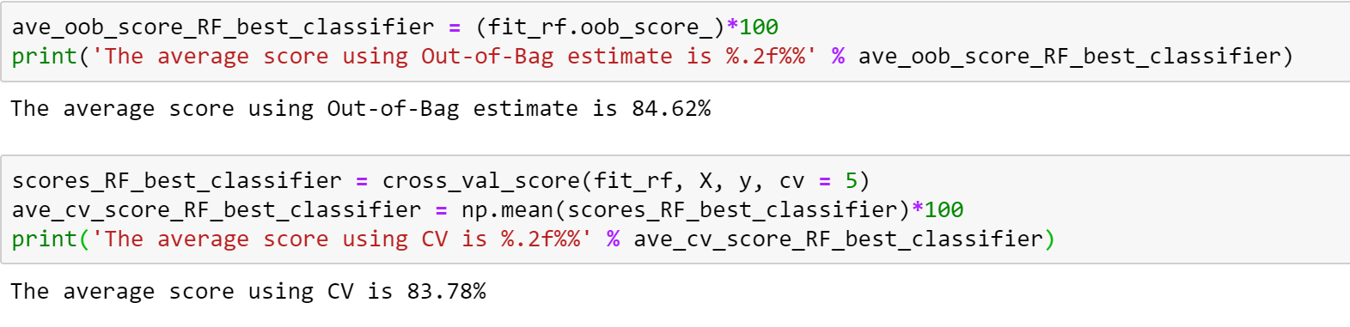
Python Code: Random Forest Classification
Random Forest Comparisons Code Classification Regression Conclusion
Instance
Set Parameters
Training
Predict
Assess
Notes:
First, we create an instance of the model. We then set the parameters based on a result of a grid search to determine optimal parameters to start with. We then train the data and form predictions based on testing data sets. We then use the score parameter which provides an accuracy of the prediction. Similar code are used for the classification and regression problem for random forests.

Slide 18
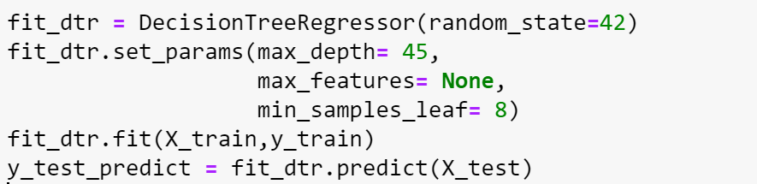
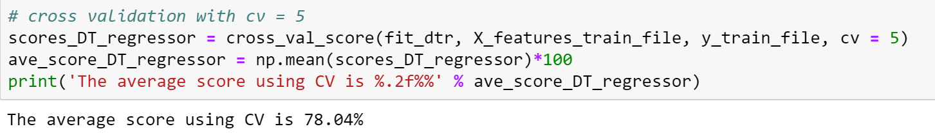
Python Code: Decision Tree Regression
Random Forest Comparisons Code Classification Regression Conclusion
Instance
Set Parameters
Training
Predict
Assess
Notes:
First, we create an instance of the model. We then set the parameters based on a result of a grid search to determine optimal parameters to start with. We then train the data and form predictions based on testing data sets. We then use the score parameter which provides an accuracy of the prediction. Similar code are used for the classification and regression problem for random forests.

Slide 19
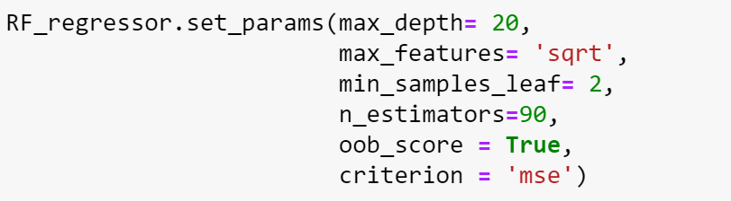
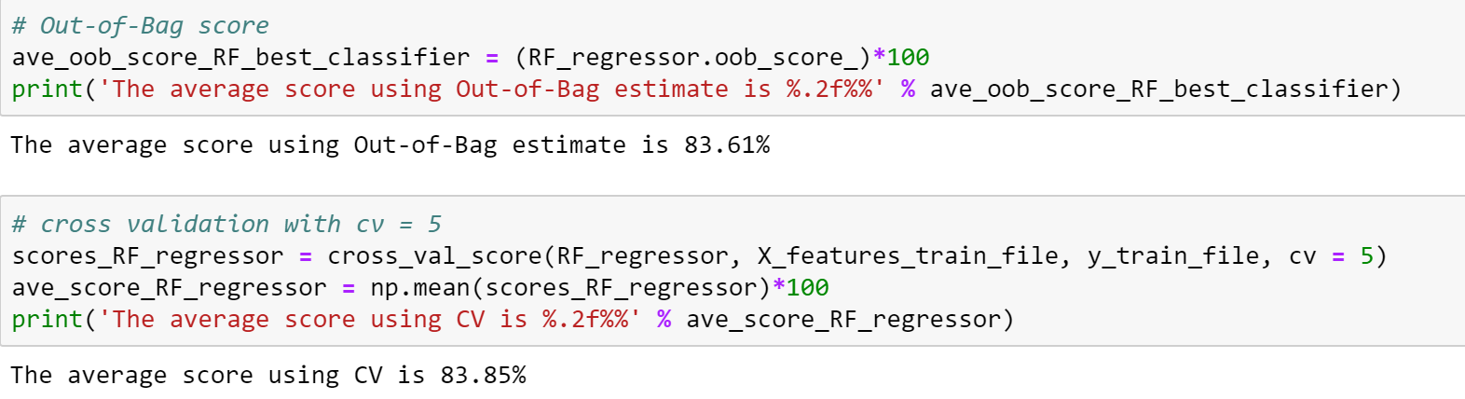
Python Code: Random Forest Regression
Random Forest Comparisons Code Classification Regression Conclusion
Instance
Set Parameters
Training
Predict
Assess
Notes:
First, we create an instance of the model. We then set the parameters based on a result of a grid search to determine optimal parameters to start with. We then train the data and form predictions based on testing data sets. We then use the score parameter which provides an accuracy of the prediction. Similar code are used for the classification and regression problem for random forests.

Slide 20

Classification
Notes:
With this, lets delve into the details and results of the classification problem.

Slide 21
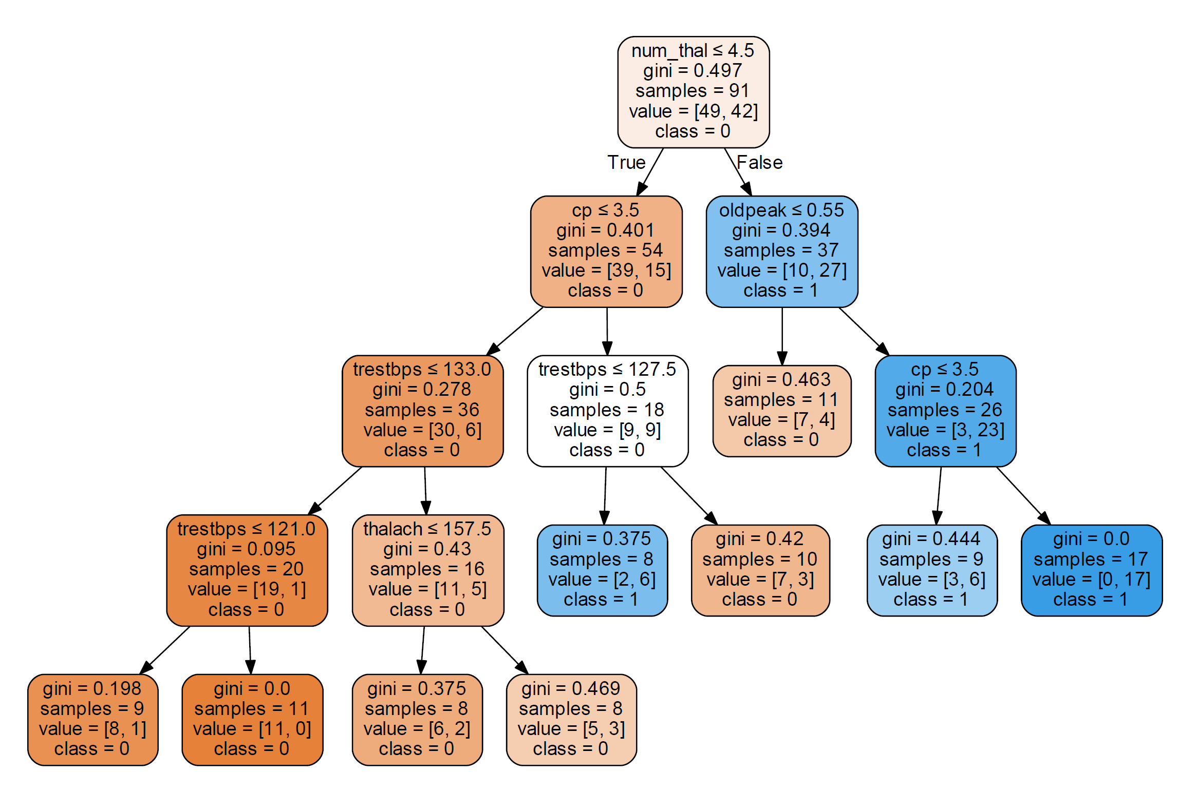
Heart Disease Prediction
Random Forest Comparisons Code Classification Regression Conclusion
Input features:
Medical history
i.e. Age, sex, num (previous heart diseases), cp (chest pain), thal (heart defect), etc.
Binary output:
1: Disease present
0: Disease not present
Notes:
Like I mentioned before, we are trying to detect heart disease for our classification problem. The features we used for this problem are the patient’s medical history, i.e. age, sex, previous heart diseases, heart defects, etc. The output is whether the patient has heart disease or not.

Slide 22
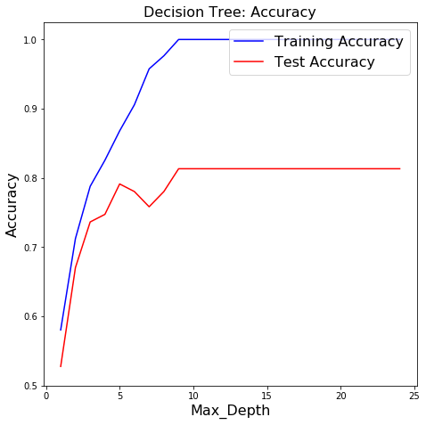
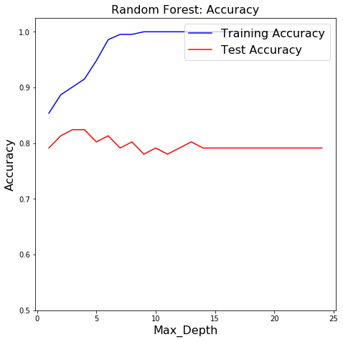
Classification: Maximize Test Accuracy
Random Forest Comparisons Code Classification Regression Conclusion
Max_depth = 9
Max_depth = 4
Notes:
Comparing the accuracy of decision tree vs random forest for various tree depths, we see that the random forest performs better for the test case even at low depths whereas the decision tree relies heavily on higher depths to achieve comparable accuracy.

Slide 23
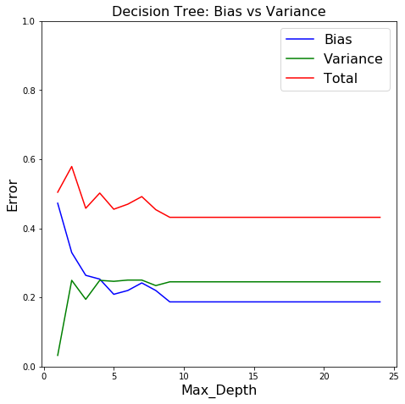
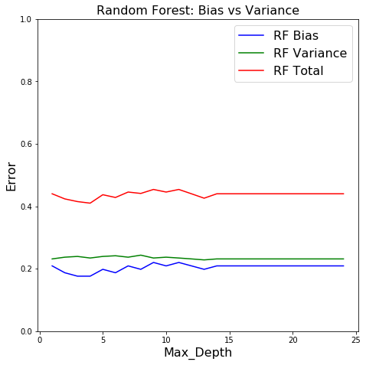
Classification: Minimize Bias & Variance
Random Forest Comparisons Code Classification Regression Conclusion
Max_depth = 9
Max_depth = 4
Notes:
The bias and variance curve for both decision trees and random forests are shown. We can see that as maximum depth increases, the bias decreases and the variance increases for decision tree. On the other hand, the bias and variance of the random forest stays relatively the same. Notably, the point at which we achieve the highest accuracy is the minimum point of the total error.

Slide 24
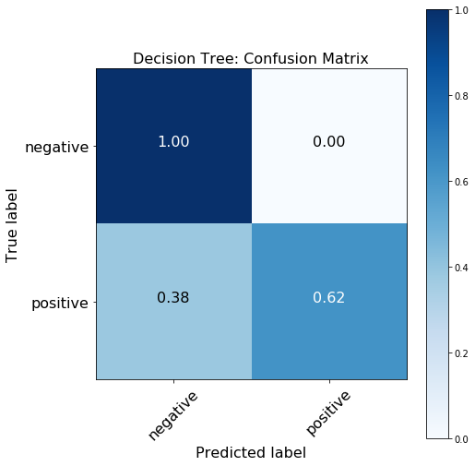
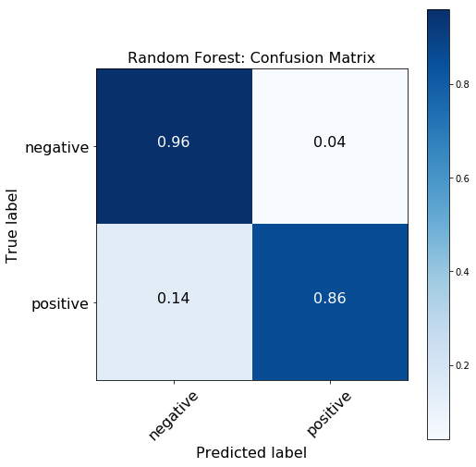
Confusion Matrix: Post-tuning
Random Forest Comparisons Code Classification Regression Conclusion
Decision Tree
Random Forest
Notes:
The results of the confusion matrix show that the decision tree produces many false positives for the test case despite high performance in the training set, suggesting overfitting. On the other hand, the confusion matrix for the random forest shows better accuracy.
Confusion Matrix for classifers with the same parameters shown for comparison.
Gini, max_depth = 3, min_samples_leaf = 2, max_features= log2

Slide 25

Regression

Slide 26
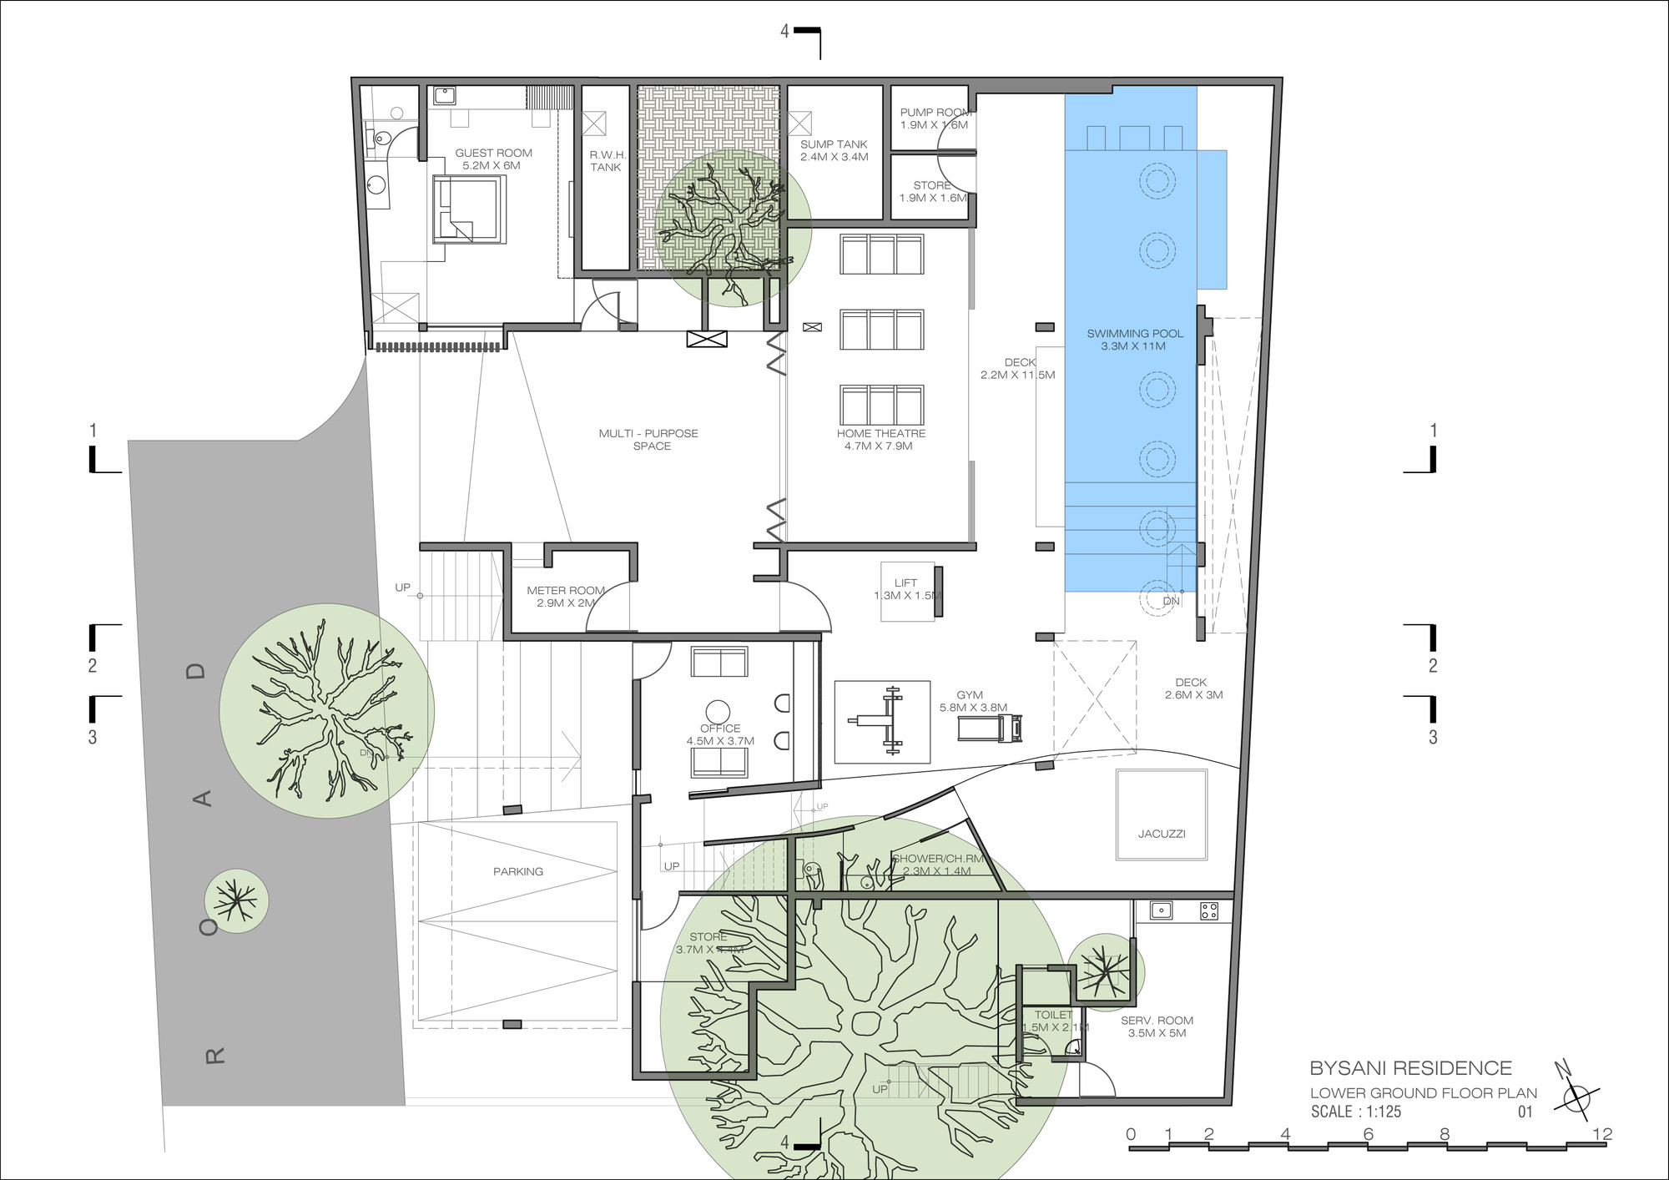
Housing Attribute Price Estimation
Random Forest Comparisons Code Classification Regression Conclusion
Input features:
House amenities i.e. pool, garage, lot area, patio space, etc.
Continuous output:
Estimated price of the house in thousands of USD
Notes:
For the regression problem, we will be looking into housing estimates based on house amenities such as the size of your patio, swimming pool, garage, particularly for a neighbourhood in Iowa. The output will be the estimated price of the house in thousands of USD.

Slide 27
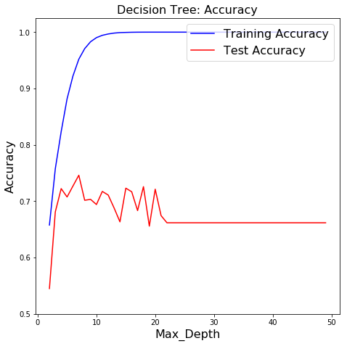
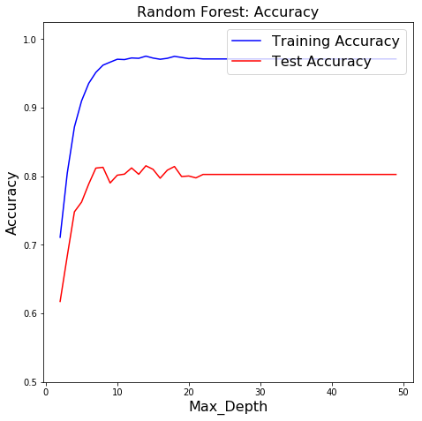
Regression: Maximize Test Accuracy
Random Forest Comparisons Code Classification Regression Conclusion
Max_depth = 4
Max_depth = 5
Notes:
The accuracy graphs are shown above for both the decision tree and random forest and we can see similar behaviour as for the classification problem. The random forest achieves and overall higher accuracy on the test data compared to a single decision tree for regression. Notably, we can see the random forest training data set is less than 100% accuracy as compared to the decision tree. This is a result of taking the mean estimate of multiple trees in the forest.

Slide 28
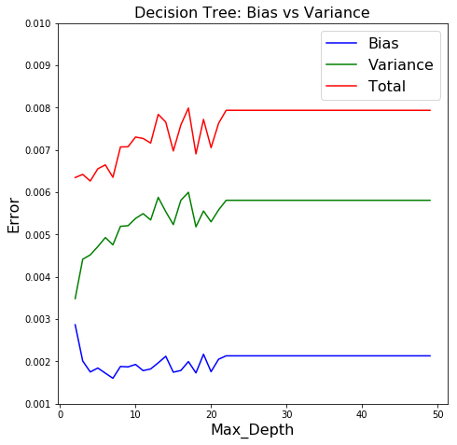
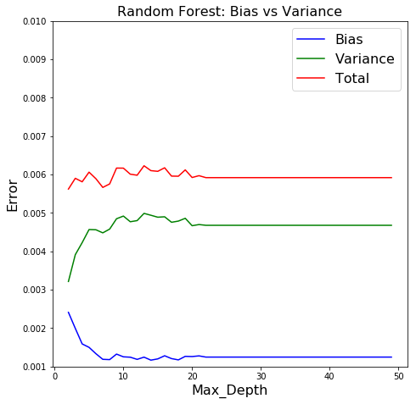
Regression: Minimize Bias & Variance
Random Forest Comparisons Code Classification Regression Conclusion
Max_depth = 5
Max_depth = 4

Slide 29
Conclusion
Random Forest Comparisons Code Classification Regression Conclusion
Demonstrated the use of both RF and DT for classification and regression problems
Discussed differences between bagging and RF
Discussed similarities and differences between cross validation and random forest

Slide 30
Thank you!
Notes:
Let’s talk about how we actually build a random forest.

Slide 31
References
https://scikit-learn.org/stable/auto_examples/ensemble/plot_ensemble_oob.html
https://scikit-learn.org/stable/modules/tree.html#tree
Cross Validation: http://blog.citizennet.com/blog/2012/11/10/random-forests-ensembles-and-performance-metrics
Evaluation Metrics: https://scikit-learn.org/0.15/model_selection.html
Hyperparameter Selection:
https://towardsdatascience.com/random-forests-and-the-bias-variance-tradeoff-3b77fee339b4
https://medium.com/@mohtedibf/indepth-parameter-tuning-for-decision-tree-6753118a03c3
Decision Tree Score: https://github.com/scikit-learn/scikit-learn/blob/ef5cb84a/sklearn/base.py#L358
https://stackoverflow.com/questions/8961586/do-i-need-to-normalize-or-scale-data-for-randomforest-r-package

Slide 32
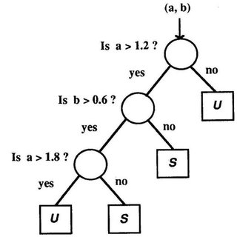
Decision Trees: Basic Unit of a Random Forest
Supervised learning used mostly for classification but can work for continuous inputs and outputs
Uses a series of logic statements to determine the variable you are trying to predict.
The goal of a decision tree to produce homogeneous subsets of the predicted variable.
Advantages:
Easy to understand
Useful in data exploration
Disadvantages
Overfitting

Slide 33
Appendix A: Boosting
Ensemble technique where multiple models are trained in sequence.
The misclassified samples of each tree are up-weighted when passed to the next tree so that each tree is building off the last.
https://www.analyticsvidhya.com/blog/2015/11/quick-introduction-boosting-algorithms-machine-learning/

Slide 34
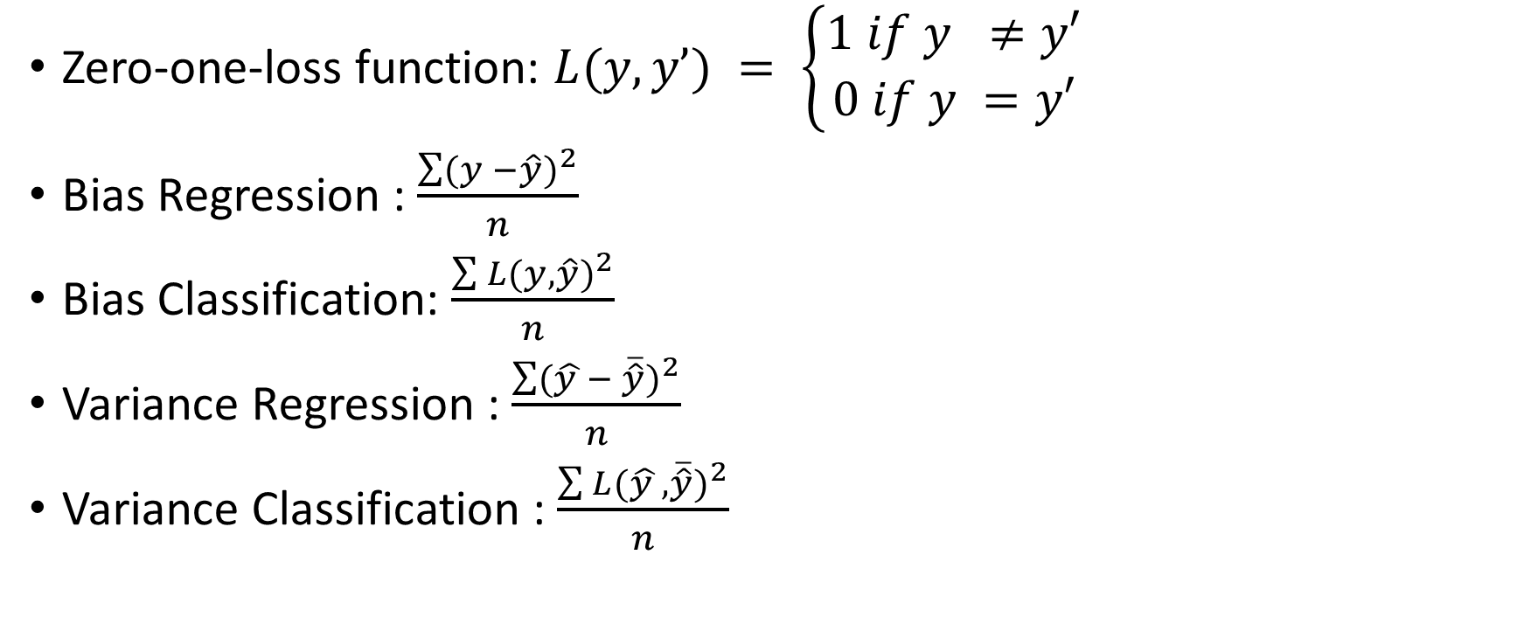
Appendix B: Bias & Variance Formula
Zero-one-loss function: $L(y,y’) = \left\{\begin{aligned}1 if y ≠y′ \\ 0 if y =y′\end{aligned}\right.$
Bias Regression : $\frac{\sum{{(y −\hat{y})}^{2}}}{n}$
Bias Classification: $\frac{\sum{{L(y,\hat{y})}^{2}}}{n}$
Variance Regression : $\frac{\sum{{(\hat{y }− \overline{\hat{y}})}^{2}}}{n}$
Variance Classification : $\frac{\sum{{L(\hat{y }, \overline{\hat{y}})}^{2}}}{n}$

Slide 35
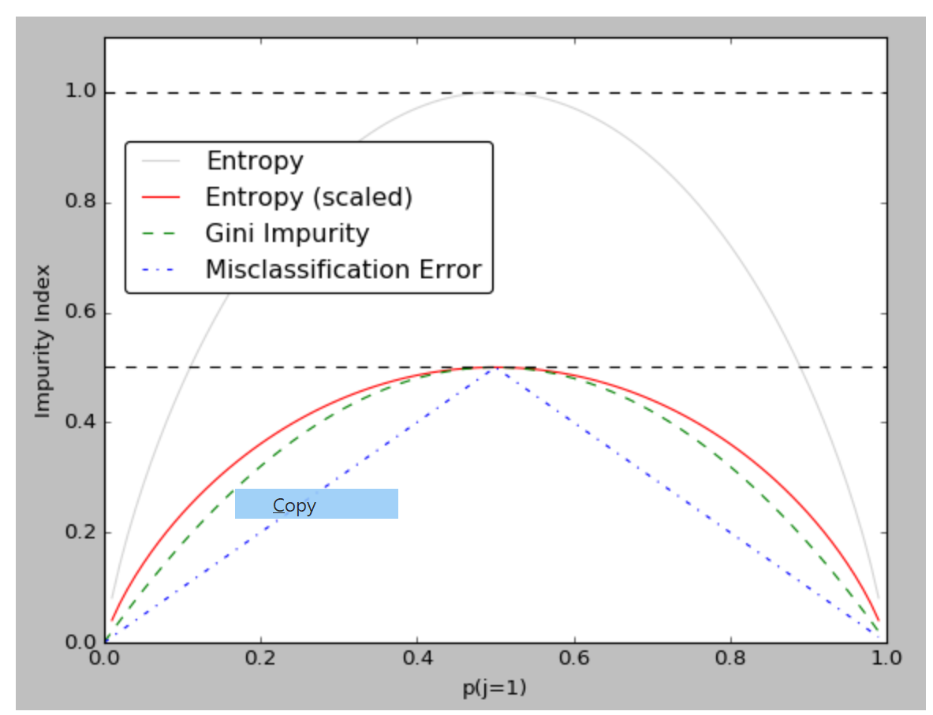
Appendix C: Loss Functions
Entropy
Gini Index
Misclassification Error
https://www.bogotobogo.com/python/scikit-learn/scikt_machine_learning_Decision_Tree_Learning_Informatioin_Gain_IG_Impurity_Entropy_Gini_Classification_Error.php

Slide 36
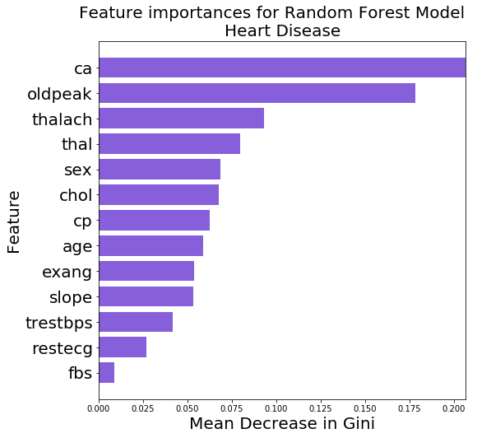
Appendix D: Variable Importance

Slide 37
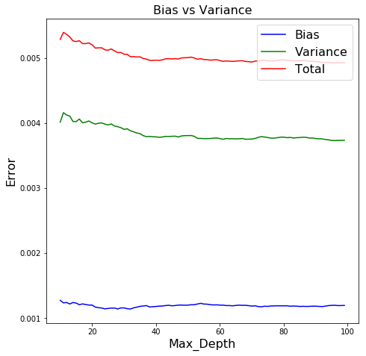
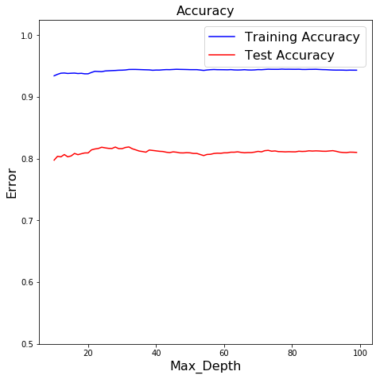
Regression: N_estimators tuning
Random Forest Comparisons Code Classification Regression Conclusion

Slide 38
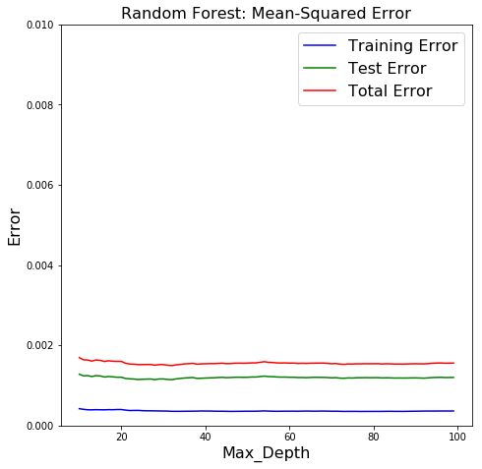
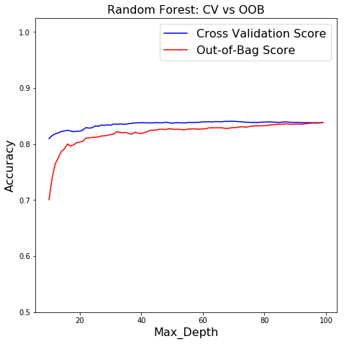
Regression: N_estimators tuning
Random Forest Comparisons Code Classification Regression Conclusion

Slide 39
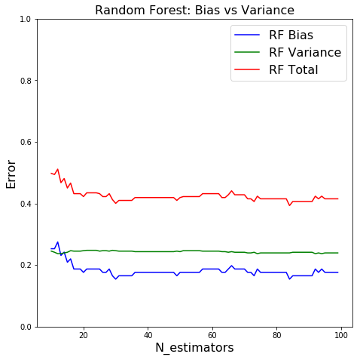
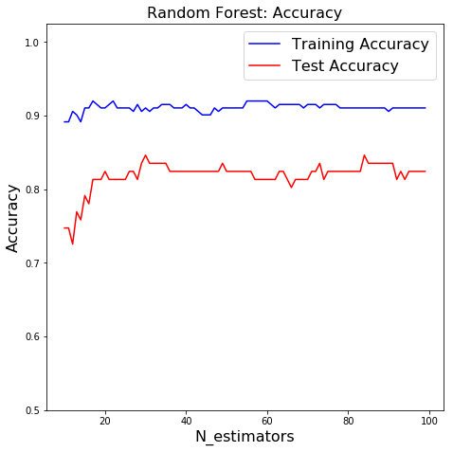
Classification: N_estimator Tuning
Random Forest Comparisons Code Classification Regression Conclusion
Notes:
Comparing the accuracy of decision tree vs random forest for various tree depths, we see that the random forest performs better for the test case even at low depths whereas the decision tree relies heavily on higher depths to achieve comparable accuracy.

Slide 40
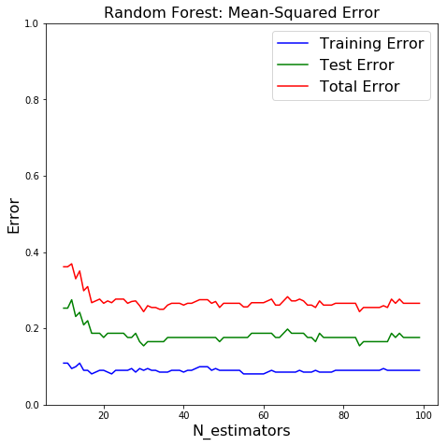
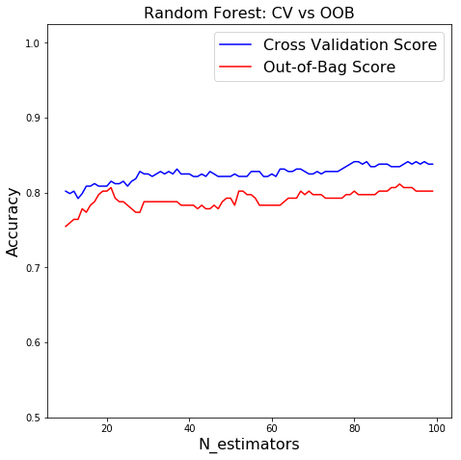
Classification: N_estimator Tuning
Random Forest Comparisons Code Classification Regression Conclusion
Notes:
Comparing the accuracy of decision tree vs random forest for various tree depths, we see that the random forest performs better for the test case even at low depths whereas the decision tree relies heavily on higher depths to achieve comparable accuracy.
When

Slide 41
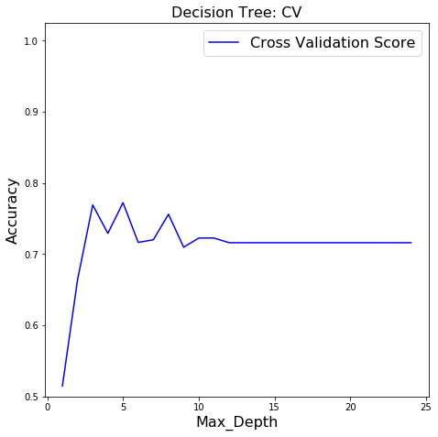
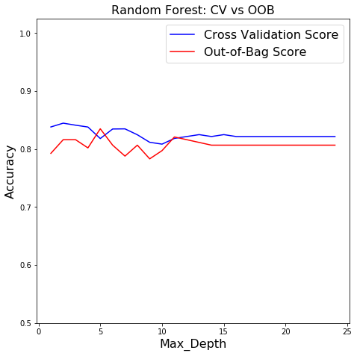
Classification: Cross Validation & OOB
Random Forest Comparisons Code Classification Regression Conclusion
Notes:
The bias and variance curve for both decision trees and random forests are shown. We can see that as maximum depth increases, the bias decreases and the variance increases for decision tree. On the other hand, the bias and variance of the random forest stays relatively the same. Notably, the point at which we achieve the highest accuracy is the minimum point of the total error.

Slide 42
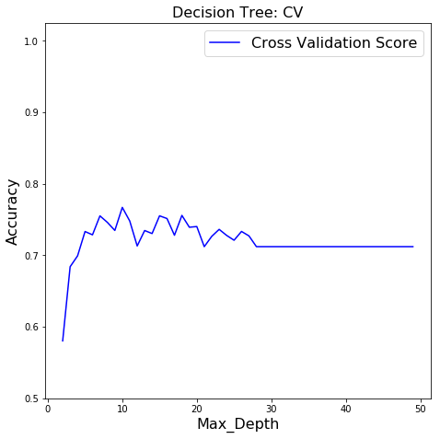
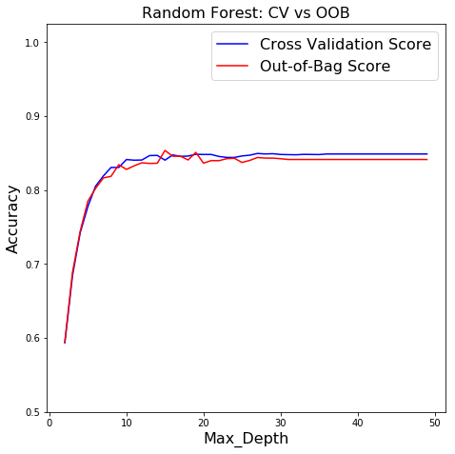
Regression: Cross Validation & OOB
Random Forest Comparisons Code Classification Regression Conclusion

